Slide 1


Project Management

Slide 2
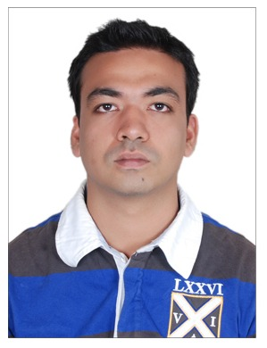
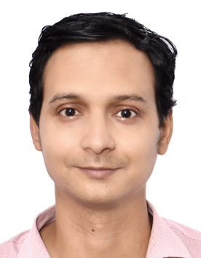

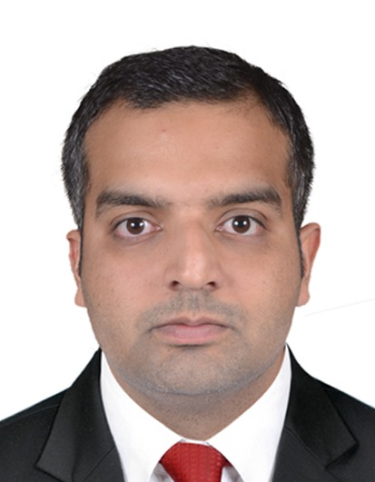
Abhinav Singh Voria
Team Members
Robin Varma
Rohit Verma
Adeel Hassan

Slide 3
ShopEease: Navigate with ease
A fashion e-commerce site called ShopeEase has a huge selection of clothes and accessories for Men's, Women's, and Children's wear.
ShopeEase seeks to improve all aspects of the user experience by offering a visually appealing and intuitive interface that makes it simple for customers to browse and find the products they want.
Notes:
Introducing ShopeEase, your ultimate destination for a wide range of stylish clothes and accessories for Men's, Women's, and Children's wear. We understand the common challenges users face while shopping online, and our mission is to provide a seamless and delightful experience for every customer. The website tries to solve the problems users frequently run into when utilizing online buying platforms.
Our visually appealing and intuitive interface makes browsing and finding your desired products a breeze. With ShopeEase, say goodbye to navigational challenges, as our user-friendly design ensures a hassle-free shopping journey.
Every visitor will have a seamless and delightful buying experience thanks to the website's simplicity and intuitive design, which will remove navigational challenges.
Key Features:
User-Friendly Interface: Enjoy a simple and intuitive platform, making product discovery and browsing a breeze.
Extensive Selection: Find a vast array of fashion products for Men, Women, and Children, catering to diverse tastes.
Advanced Search & Filters: Easily locate specific items based on your preferences with our powerful search and filtering options.
Responsive Design: Shop seamlessly across devices - PCs, tablets, and mobiles - for a smooth purchasing experience.
Secure Checkout: Your privacy is our priority! We use secure payment gateways and encryption to protect your data.

Slide 4
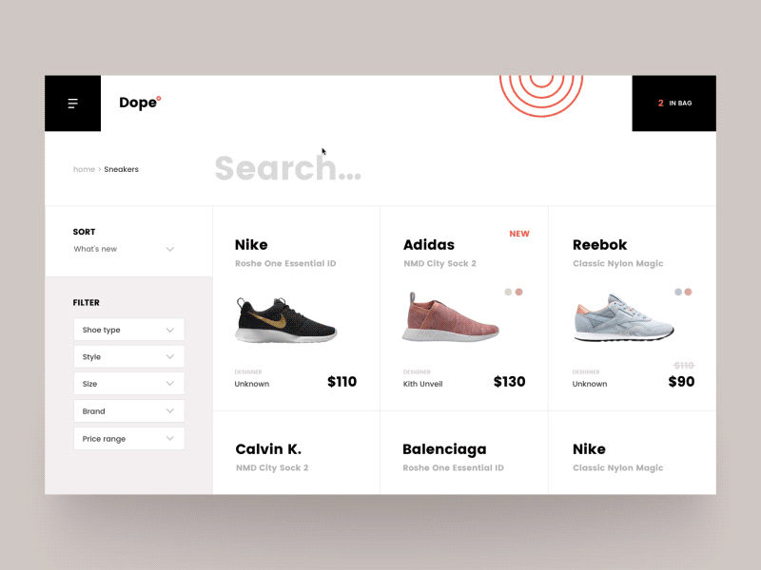
Problem
Problem to resolve
Due to its focus on navigation & user experience, ShopeEase differentiates apart from other fashion e-commerce websites.
The difficulty clients encounter when searching via online fashion stores is the main issue it addresses.
Notes:
This slide Presents the Uniqueness and Problem-Solving Approach of the website
ShopeEase stands out from other fashion e-commerce sites by focusing on navigation and user experience.
Our solution addresses the common frustration users face while shopping online for fashion. Complex designs and confusing navigation are widespread issues.
ShopeEase tackles this head-on, providing a user-friendly interface that streamlines the buying process.
Enjoy quick access to products and intuitive navigation, enhancing customer satisfaction, driving sales, and fostering brand loyalty. Numerous websites have complicated designs and perplexing navigation, which can cause frustration and bounce rates.
By offering a user-friendly and straightforward interface, ShopeEase addresses this problem and streamlines the buying process.

Slide 5
Goals & Objective
Goal:
The project’s focus is to create and deploy a user-friendly e-commerce website for a retail business that allows users to browse and purchase products, maintain their accounts, and deliver a seamless checkout experience.
Objective
Create a Simple and User-Friendly user interface that improves the shopping experience while also reflecting the company's brand.
Develop and implement a Website launch strategy to boost website visibility, traffic, and conversion rates.
Constantly monitor website analytics, consumer comments, and sales statistics to find and improve areas for development.

Slide 6
Teams for the project.
Front-end Development
Back-end Development
Designing a user interface (UI)
Creating preliminary wireframes, which will help us plan the website's layout and structure
Use HTML and CSS to create the website's visual design and layout.
Database management will rely on MySQL to store essential data such as product information and client details securely
Notes:
Front-end and Back-end Development, UI Design
In this slide, we will explore the key components of our website development process.
On the front-end, we will use HTML and CSS to create the website's visual design and layout. JavaScript will be employed to implement interactive features and dynamic functionalities, enhancing user engagement. To ensure a seamless user experience across various devices, we will incorporate media queries and responsive design guidelines, allowing the site to adapt to different screen sizes.
For the back-end, we have chosen PHP as our server-side programming language to provide robust logic and functionality. Our database management will rely on MySQL to store essential data such as product information and client details securely.
To ensure an intuitive user interface, we will begin by creating preliminary wireframes, which will help us plan the website's layout and structure. Additionally, interactive prototypes will be developed to test and gather valuable user feedback, allowing us to refine the user interface concept and optimize user satisfaction.
The combination of front-end and back-end development, along with thoughtful UI design, will deliver an seamless user experience on our website.

Slide 7
Work Breakdown Structure (WBS):
Stakeholder Management
Risk Management
Progress Tracking
UI/UX Design
Wireframing and Prototyping
Front-end Coding
Responsive Design Implementation
Back-end Development and Database Integration
Server Setup and Configuration
Database Design and Development
Back-end Coding
API Integration
Third-Party Service Integration
Payment Gateway Integration
Shipping Provider Integration
Inventory Management System Integration
Testing and Quality Assurance
Unit Testing
Functional Testing
Performance Testing
Security Testing
ShopEase
Project Planning
Launch Strategy and Marketing
SEO Optimization
Marketing Campaign Planning
Social Media Integration
Content Population
Product Data Entry
Image and Description Upload
Training and Documentation
Website Administration Training
User Documentation Preparation
Front-end Design and Development
Project Management

Slide 8
Scope of the project
Objective | To develop an E-commerce website for providing seamless experience throughout the website to users.
Project Constraints | The website will be completed within the budget of € 7000.
In-scope of project | Front-end development and design Database integration and back-end development Integration with third-party services (for example, payment gateways and shipping companies) Testing and quality control Initial content generation (for example, product data, photos, and descriptions) Website administration training and documentation
Out of scope | Creation of the mobile application. Maintenance of the Website. Integration with internal systems that are not identified.
Deliverables | A fully developed e-commerce website that has an appealing and user-friendly user interface. Integrated with third-party services that include payment gateways, and other related systems.
Notes:
Objective:
Our main objective is to develop a cutting-edge e-commerce website that provides a seamless and delightful experience for our users. We aim to create a platform where customers can easily browse and purchase products while enjoying a user-friendly interface.
Project Constraints:
We have set a budget of €7000 for this project, and we will utilize various resources, including business products, to achieve our goals. To ensure success, we will build a skilled and experienced team comprising developers, UX/UI experts, and designers.
In-scope of Project:
This project encompasses front-end development and design, database integration, and back-end development. We will also integrate third-party services, such as payment gateways and shipping companies, to enhance the functionality of the website. Testing, quality control, launch strategy, and marketing initiatives are all part of our scope. Additionally, we will handle initial content generation and provide website administration training and documentation.
Out of Scope:
While our focus is on website development, we will not create a mobile application as part of this project. Maintenance of the website and integration with unidentified internal systems are also out of scope.
Deliverables:
Upon completion, we will deliver a fully functional e-commerce website with an appealing and user-friendly user interface. The website will be seamlessly integrated with third-party services, including payment gateways and logistic providers, ensuring a smooth shopping experience for our customers.

Slide 9
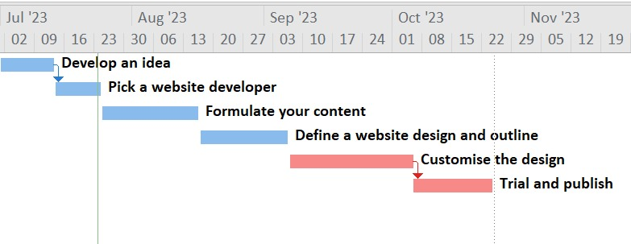
Schedule Plan
Notes:
Project Execution Plan
This slide outlines the step-by-step project execution plan to achieve our goal of developing a seamless e-commerce website within the specified timeframe.
Concept Finalization:
The first stage involves finalizing the concept for the website development. We will gather requirements, identify the target audience, and define the scope of the project.
Team Selection:
Once the concept is clear, we will assemble a team of skilled and experienced developers who will be dedicated to the development process.
Content Development:
The selected team will work on creating and gathering the content required for the website. This includes product data, images, descriptions, and other relevant information.
Website Design:
Next, we will focus on designing the website's layout and outline, ensuring it aligns with the client's vision and objectives.
Customization:
To meet specific client needs, we will customize the design and features, tailoring the website to deliver a personalized experience.
Testing and Issue Resolution:
Before launch, we will rigorously test the website to identify and resolve any issues or bugs that may arise.
Website Publication:
Once all testing and improvements are complete, the website will be ready for publication, making it accessible to our target audience.
By following this well-structured plan, we are confident in achieving our goal of delivering a top-notch e-commerce website within the set timeframe. Our team's expertise and dedication will ensure a successful outcome for our client and a seamless shopping experience for users.

Slide 10
Project Budget
Particulars | Amount
Resources
Web Developers | € 488.00
Designers | € 655.00
Content Creators | € 360.00
SEO Specialists | € 445.00
Domain Name
Annual | € 25.00
Multi-year Registration Fees | € 35.00
Web Hosting
Vps | € 88.00
Cloud | € 105.00
Platform For The Website | € 555.00
Web Development And Design | € 1,250.00
Responsive Design | € 255.00
Media And Graphics
Costs Of Acquiring High-quality Images | € 366.00
Graphic Designer | € 125.00
E-commerce Services | € 360.00
Marketing And Search Engine Optimization (SEO)
Online Marketing Campaigns | € 125.00
Social Media Ads | € 136.00
Google Ads | € 112.00
Reserves | € 120.00
Security Options | € 166.00
Updates And Maintenance | € 90.00
Quality Assurance And Testing | € 363.00
Support | € 266.00
Outsourcing | € 388.00
Total | € 6,878.00
Notes:
Project Budget Breakdown
This slide provides a detailed breakdown of the project budget for developing our e-commerce website. The total budget amounts to €6,878.00. Here's a summary of the key expenses:
Resources: The allocation for web developers, designers, content creators, and SEO specialists amounts to €1,948.00, covering the skilled team responsible for website development.
Domain Name and Web Hosting: The domain name registration and multi-year hosting fees sum up to €60.00, ensuring a solid online presence.
Platform and Web Development: The website platform costs €555.00, while web development and design expenses are €1,250.00, ensuring a robust and visually appealing website.
Media and Graphics: High-quality images and graphic design services amount to €491.00, enhancing the website's visual appeal.
E-commerce Services: €360.00 is allocated to integrating e-commerce features, facilitating smooth online transactions.
Marketing and SEO: The budget for online marketing campaigns, social media ads, and Google Ads totals €373.00, driving targeted traffic to the website.
Security, Maintenance, and Support: €456.00 is set aside for security options, updates, quality assurance, and ongoing support, ensuring a safe and well-maintained website.
Reserves and Outsourcing: A contingency reserve of €120.00 is included, along with €388.00 for any potential outsourcing needs.
By meticulously allocating the budget, we aim to deliver a high-quality e-commerce website that provides a seamless and delightful shopping experience for our users, within the allocated budget.

Slide 11
Agile Roles in ShopEase
Scrum Master
Guide the team,
Remove impediments,
Facilitate meetings
AGILE
Product Owner
Prioritize backlog,
Gather demands,
Communicate with stakeholders.
Development Team
Collaborate, design,
Develop, test,
Self-organize.
Notes:
Agile Roles in ShopEase Website Development
Product Owner: Represents the company and enhances website value. They define and prioritize the product backlog, gather stakeholder demands, and ensure alignment with business goals. They communicate with developers and participate actively in sprint evaluations.
Scrum Master: Guides the Agile team, ensuring adherence to Agile practices. They facilitate communication, remove obstacles, and shield the team from interruptions. They monitor and promote Agile principles throughout the development process.
Development Team: Cross-functional individuals responsible for incremental delivery of the e-commerce website. They collaborate, design, develop, and test features from the product backlog. They self-organize to achieve sprint goals.

Slide 12
Scrum for ShopeEase Website Development
Sprint Planning
Daily Stand-up
Sprint Review
Sprint Retrospective
Ensure manageable commitments from the team.
Identify and remove hurdles to stay on track.
Showcase features to stakeholders, gather feedback for future sprints.
Reflect on achievements, seek improvements, and promote open dialogue and teamwork.
Notes:
Scrum for ShopeEase Website Development
Sprint Planning: The project manager, Product Owner, and development team collaborate to select high-priority tasks for the upcoming sprint. They divide tasks and estimate workload. The project manager ensures a manageable commitment from the team.
Daily Stand-up: Daily stand-ups, led by the project manager, facilitate progress updates, obstacle discussions, and task scheduling. The project manager identifies and removes obstacles to keep the team on track.
Sprint Review: After each sprint, the project manager arranges a review meeting where the development team showcases completed features to stakeholders. Stakeholders provide feedback, and necessary changes are noted for future sprints.
Sprint Retrospective: Led by the project manager, the team reflects on sprint achievements and seeks areas for improvement. Open dialogue and teamwork promote practical solutions to enhance performance in the next sprint.

Slide 13
Progress tracking: Kanban for ShopeEase
Visual Board
Continuous Delivery
Set up a Kanban board to visualize phases - "To Do," "In Progress," "Completed." Efficiently track progress.
Embrace continuous delivery for regular stakeholder updates. Validate features and receive early feedback.
Kanban
WIP Limit
Continuous Improvement
Apply work-in-progress restrictions for each stage. Maintain a consistent workflow and prevent overloading.
Conduct team meetings to improve workflow, simplify processes, and enhance productivity. Collaboratively optimize website development.
Notes:
Kanban for ShopeEase Website Development
Visual Board: A Kanban board will be set up to visualize the different phases of website development - "To Do," "In Progress," and "Completed." The team can track progress and workflow efficiently.
WIP Limit: Work-in-progress restrictions will be applied to each stage on the Kanban board. This ensures a consistent workflow and prevents the team from being overburdened.
Continuous Delivery: We will adopt continuous delivery to regularly deliver finished work to stakeholders. This facilitates continuous improvement, validation of implemented features, and early feedback.
Continuous Improvement: Regular team meetings will be arranged to examine workflow, simplify processes, and enhance productivity. Collaboratively, we will optimize ShopeEase website creation and discuss potential upgrades.

Slide 14
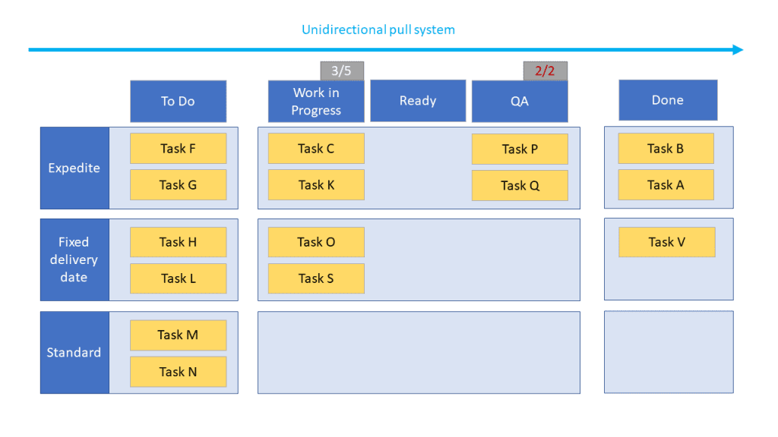
Notes:
Visual Board: A Kanban board will be set up by me to reflect the various phases of the ShopeEase website's development, such as "To Do," "In Progress," and "Completed." The team will be able to track task progress and visualize the workflow using the board.
WIP Limit: On the Kanban board, the project manager will set work-in-progress restrictions for each stage of the workflow. To ensure a consistent workflow, project manager will make sure that the number of tasks that can be carried out concurrently.
Continuous Delivery: To ensure that finished work is regularly given to stakeholders, project manager will push the team to use a continuous delivery method.
Continuous Improvement: project manager will arrange regular team meetings to examine workflow, find possibilities for process simplification, and boost productivity. The team will collaborate to create modifications that optimize the creation and delivery of the ShopeEase website while also discussing prospective upgrades.

Slide 15
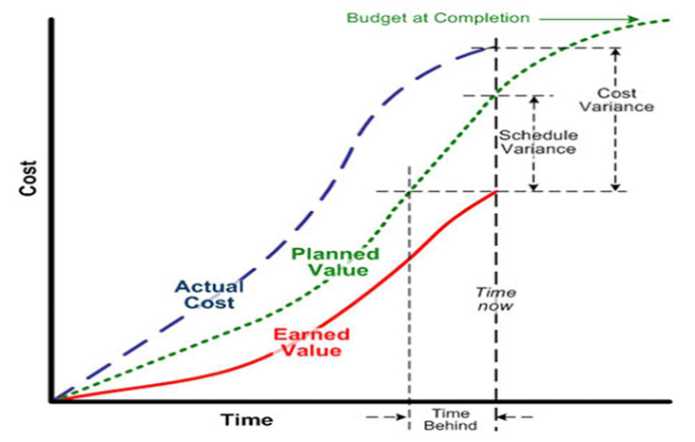
Data Insights
Notes:
To analyse project performance and detect potential difficulties or deviations, EVM analysis compares intended values, actual costs, and earned value.
Assumption: We have also done a cost assumption after 50% completion of the project which we have shown in the project.

Slide 16
Solution Development Team Management in ShopEase Website Development
Consistent Meetings
Organize Sprint Planning Session
Daily Stand-up Meeting Facilitation
Organize Sprint Review Meetings
Facilitate Retrospective Meetings
Notes:
Solution Development Team Management in ShopeEase Website Development
Organize Sprint Planning Sessions: The project manager collaborates with the Product Owner and development team to schedule tasks for each sprint, ensuring alignment with project goals and creating sprint targets.
Daily Stand-up Meeting Facilitation: Daily stand-up meetings are led by the project manager to discuss progress, resolve issues, and plan daily tasks, promoting transparency and focus.
Organize Sprint Review Meetings: The project manager arranges sprint review meetings to showcase completed features to stakeholders, gather input, validate outputs, and make necessary adjustments for future sprints.
Facilitate Retrospective Meetings: After each sprint, the project manager conducts retrospective meetings to discuss team performance, identify improvement areas, and implement plans to enhance collaboration and productivity in upcoming sprints.

Slide 17
Tools for Collaboration
Use Project Management Software
Jira - Trello
Leverage Communication Tools
Slack / Teams
Implement Version Control Systems
Git / Apache Allura
Notes:
Tools for Collaboration
Project Management Software: The project manager will utilize tools like Jira or Trello to track tasks, allocate responsibilities, and monitor the development team's progress. This ensures efficient project scheduling and clarity of roles.
Communication Tools: To foster rapid and effective communication among team members, the project manager recommends using communication platforms like Slack or Microsoft Teams. These tools facilitate seamless file sharing, real-time collaboration, and prompt response to queries.
Version Control Systems: Implementing version control technologies like Git enables effective code management. The development team can coordinate code changes, track revisions, and resolve conflicts throughout the development process, promoting code integrity.

Slide 18
Teamwork and Issue Resolution
Clearly Specify Tasks and Duties
Address problems Quickly
Foster Trust and Respect
Encourage Regular Communication and Knowledge Sharing
Develop Problem-Solving Skills
Notes:
Teamwork and Issue Resolution
Clearly Specify Tasks and Duties: The project manager ensures that each team member understands their roles and responsibilities. Clear task definitions facilitate effective work allocation and prevent misunderstandings.
Encourage Regular Communication and Knowledge Sharing: The project manager promotes regular information exchange among team members, fostering a collaborative environment. This encourages cross-functional learning and enhances overall productivity.
Develop Problem-Solving Skills: Team members are empowered to adopt a problem-solving mentality, with support and guidance when needed, fostering a proactive approach to tackling challenges.
Address Problems Quickly: Conflict resolution protocols are established to address issues promptly, minimizing their impact on the project. Open communication facilitates timely resolution.
Foster Trust and Respect: Cultivating a culture of respect and trust encourages open expression of ideas, concerns, and suggestions. Mutual trust among team members leads to effective collaboration and successful project outcomes.

Slide 19
Communication Plan
Stakeholder Identification
Reporting Structure
2023
Communication methods
Paperwork
Time and Frequency
Escalation method
Notes:
Communication Plan
Stakeholder Identification: The project manager will identify key stakeholders, including business owners, managers, and marketing staff, to understand their interests and needs in the ShopeEase project.
Communication Methods: Tailored communication methods, such as email, online conferences, and project management software, will be chosen based on stakeholders' preferences and accessibility to keep them updated and address concerns promptly.
Time and Frequency: The project manager will set appropriate interaction frequencies for each stakeholder, providing regular updates without overwhelming them with information.
Reporting Structure: A clear reporting system will ensure relevant information reaches the right parties. The project manager will define responsible individuals for each stakeholder and the level of detail provided.
Paperwork: The project manager will decide on the types of reports and documents to share during the project, including progress updates, project plans, and meeting minutes, to keep stakeholders informed.
Escalation Method: Implementing an escalation method will enable the project manager to address major issues or obstacles promptly, ensuring swift resolution throughout the development process.

Slide 20
Regular Status Reports
Summary of accomplishments since the last report
Revisions to expenditures and resources
Risks and issues with mitigation techniques
Work done and forthcoming activities are summarized as follows
Deliverables and milestones reached
Change requests and their effect
Notes:
Regular Status Reports
To keep stakeholders informed about ShopeEase website development, the project manager will send frequent status reports. These reports will include the following:
Summary of Accomplishments: Highlighting progress and achieved milestones to ensure stakeholders are updated on the development process.
Work Done and Upcoming Activities: Providing visibility into the project's trajectory by summarizing completed tasks and upcoming activities.
Deliverables and Milestones Reached: Reporting on completed milestones to demonstrate project success and timeliness.
Revisions to Expenditures and Resources: Sharing information on expenditure and resource allocation for stakeholders' financial assessment.
Risks and Mitigation Techniques: Visibility on potential risks and their mitigation assures stakeholders of effective risk management.
Change Requests and Their Impact: Clearly articulating change requests and their implications for informed decision-making.

Slide 21
Incorporating and Gathering Feedback
Obtaining Review
Consistent Participation
Assessment and Prioritization
Examination
Transparent Conversations
Implement change control for thorough evaluation of requested adjustments.
Offer survey forms, email, and feedback meetings for stakeholder input.
Engage stakeholders regularly throughout the project for timely and valuable input.
Analyze feedback, prioritize changes aligned with project goals.
Communicate openly with stakeholders, establish trust, manage expectations effectively.
Notes:
Incorporating and Gathering Feedback
To ensure a successful website development, the project manager will actively seek and incorporate stakeholder feedback throughout the project. The following strategies will be implemented:
Mechanisms for Obtaining Review: Specific avenues like survey forms, email, and feedback meetings will be provided for stakeholders to contribute their ideas and comments.
Consistent Participation: Regular engagement with stakeholders throughout the project's life cycle will ensure timely and meaningful input, aligning the website creation with their needs.
Assessment and Prioritization: Stakeholder comments will be analyzed to identify common themes and prioritize changes aligned with project goals.
Examination: A change control method will thoroughly assess requested adjustments, considering scope, scheduling, and cost implications.
Transparent Conversations: Stakeholders will be informed about how their feedback will be reviewed, incorporated, or managed, fostering trust and effective expectation management.

Slide 22
Stakeholder Meetings
Introduce project aims and scope, align stakeholder expectations with project goals.
Kick-off Meeting
Review Meetings
Involve stakeholders in gathering requirements and scope changes for business goals.
Provide project updates, resolve issues, address stakeholder questions in ongoing meetings.
Regular Meetings
Sample Sittings
Stakeholders view features, give input, ensure demands met during demo sessions.
Assess outcomes, gain insights, discuss improvements after project completion.
Retrospective Meetings
Notes:
Stakeholder Meetings
Throughout the project, we will hold various stakeholder meetings to foster involvement and ensure alignment with their expectations:
Kick-off Meeting: In the initial meeting, we will discuss project aims and scope, aligning stakeholder expectations with project goals.
Prerequisites Review Meetings: Stakeholders will be involved in gathering project requirements and scope changes to meet their business goals.
Regular Meetings: We will provide updates on project development, resolve issues, and address stakeholder questions in these meetings.
Sample Sittings: Stakeholders can view finished features, offer input, and ensure their demands are met during demo sessions.
Retrospective Meetings: After the project's completion, stakeholders can assess outcomes, gain insights, and discuss future improvements.

Slide 23
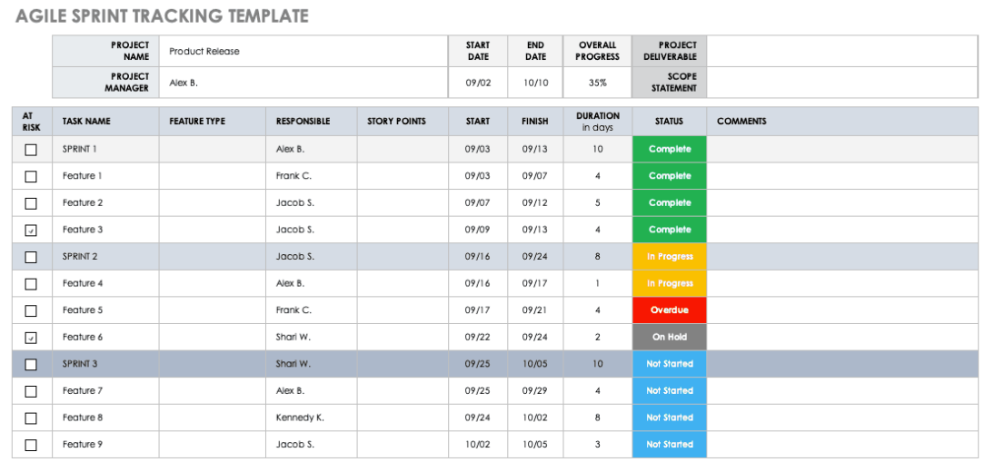
Notes:
Breaking down a task into Specific Key Performance Indicators (KPIs) and tracking them on a regular basis is a strategic approach to enhance performance, monitor progress, and achieve defined objectives.
It helps to : Break tasks into manageable components.
Define clear and specific KPIs for each component.
Ensure KPIs are measurable and quantifiable.
Align KPIs with task objectives and project goals.
Track KPIs at regular intervals (daily, weekly, etc.).
Assign responsibility for KPI tracking.
Collect data consistently to measure KPIs.
Analyze data to interpret progress and trends.
Use insights for informed decision-making.
Communicate progress to stakeholders transparently.
Make adjustments based on KPI tracking results.
Drive continuous improvement through iterative processes.

Slide 24
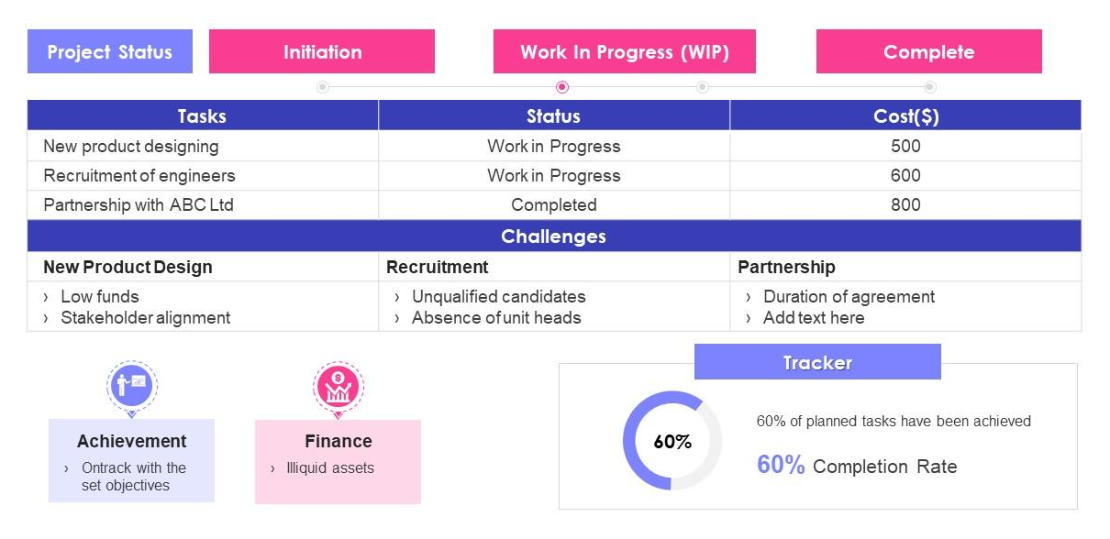
Achievement tracking
Notes:
A Comprehensive dashboard will be made on tools like Trello/Monday. Sample provided in slide.
This dashboard serves as a paramount tool to gauge the overall progression of our project.
It achieves this by aggregating and presenting critical data points, particularly when individual Key Performance Indicators (KPIs) are successfully accomplished.

Slide 25
Agile Techniques for Requirement Prioritisation
MoSCoW Prioritization
Value-Based prioritizing
AGILE TECHNIQUES
Categorize requirements as Must have, Should have, Could have, and Won't have for prioritization.
Value requirements based on business impact, customer value, and return on investment.
Organize user stories, prioritize based on significance and impact on user experience.
Classify needs based on customer satisfaction impact, focus on high-value features for a competitive edge.
User narrative Mapping
Kano Model
Notes:
Prioritization Techniques
MoSCoW: Collaborating with the product owner and stakeholders to categorize requirements as Must have, Should have, Could have, and Won't have. Enables focusing on essential features first.
User Narrative Mapping: Involving the development team and stakeholders in group workshops to organize user stories and prioritize based on significance and impact on user experience.
Value-Based Prioritizing: Including important stakeholders in sessions to value requirements based on business impact, customer value, and return on investment. High-value features are prioritized early.
Kano Model: Using the Kano model to classify needs based on customer satisfaction impact, focusing efforts on capabilities that please customers and add value, giving a competitive edge and higher satisfaction.

Slide 26
Identifying Risks
Technical Risks
Stakeholder Risks
External Risks
Project Management Issues
Evaluate device/browser compatibility, data security, and performance bottlenecks for early mitigation.
Consider regulatory changes, competition, and supplier reliance for contingency planning.
Be cautious of shifting needs and lack of involvement, manage competing agendas.
Identify risks in planning, resource allocation, scope, and communication for effective management.
Notes:
Identifying Risks
Technical Risks: Evaluating technological risks like compatibility issues, security shortcomings, and performance bottlenecks for early mitigation.
Stakeholder Risks: Being cautious about stakeholder involvement, identifying shifting needs, lack of participation, or competing agendas.
External Risks: Examining external factors such as regulatory changes, competition dynamics, and supplier reliance for contingency planning.
Project Management Issues: Identifying risks related to project planning, resource allocation, scope creep, and communication for effective project management.

Slide 27
Future Roadmap
Post-launch Evaluation And Analysis:
Performance analysis
Technical Improvements
Continuous maintenance
Optimization and enhancement
Feature expansion
User feedback
Security enhancement
Data analytics
Future
Innovation
Emerging Technologies
User Generated Content

Slide 28
Stakeholder analysis
Name of Stakeholder | Impact Level | Level of Support | Reason for Resistance | Action to Be Taken
Product Owner | High | Strong Support | N/A | Continue collaboration and involve in decision-making processes.
Development Team | High | Strong Support | N/A | Provide resources, support, and clear communication channels.
UX/UI Designers | Medium | Strong Support | N/A | Encourage creativity and regular feedback sessions to meet design needs.
Marketing Team | Medium | Strong Support | N/A | Collaborate on product launches and promotional activities.
Customers | High | High Support | N/A | Conduct user surveys and collect feedback for continuous improvement.
Project Manager | High | Strong Support | N/A | Ensure project goals and objectives are met, and address any challenges.
CEO/Management | High | Strong Support | N/A | Regularly communicate project progress and seek approval on key decisions.
IT Support Team | Medium | Strong Support | N/A | Collaborate to ensure seamless integration and resolve technical issues.
Competitors | Medium | Neutral Support | Market Competition | Monitor competitor strategies and differentiate to attract customers.
Investors | High | Neutral Support | Financial Risk | Provide regular updates on project progress and financial stability.
Regulators/Government | High | Strong Support | Compliance Requirements | Ensure adherence to regulations and obtain necessary approvals.
Suppliers | Medium | Neutral Support | Business Relations | Maintain good relations and timely procurement of required resources.
Notes:
Stakeholder Analysis
Product Owner: The Product Owner has a high impact level and strong support. As a key decision-maker, continued collaboration and involvement in decision-making processes are essential.
Development Team: With a high impact level and strong support, the Development Team requires resources, support, and clear communication channels to ensure successful implementation.
UX/UI Designers: The UX/UI Designers have a medium impact level and strong support. Encourage creativity and hold regular feedback sessions to meet design needs effectively.
Marketing Team: Having a medium impact level and strong support, collaboration with the Marketing Team on product launches and promotional activities is crucial.
Customers: They have a high impact level and high support. Conduct user surveys and gather feedback for continuous improvement and customer satisfaction.
Project Manager: With a high impact level and strong support, the Project Manager ensures project goals are met and addresses any challenges throughout the process.
CEO/Management: Having a high impact level and strong support, regular communication of project progress and seeking approval on key decisions is necessary.
IT Support Team: The IT Support Team holds a medium impact level and strong support. Collaborate to ensure seamless integration and timely resolution of technical issues.
Competitors: They have a medium impact level and neutral support. Monitor competitor strategies and differentiate to attract customers effectively.
Investors: With a high impact level and neutral support, provide regular updates on project progress and financial stability to address potential financial risks.
Regulators/Government: They have a high impact level and strong support due to compliance requirements. Ensure adherence to regulations and obtain necessary approvals.
Suppliers: They hold a medium impact level and neutral support. Maintain good relations and ensure timely procurement of required resources for the project's success.

Slide 29
References
Bass, J.M., Beecham, S., Razzak, M.A., Canna, C.N. and Noll, J., 2018, May. An empirical study of the product owner role in scrum. In Proceedings of the 40th International Conference on Software Engineering: Companion Proceeedings (pp. 123-124).
Moreau, M., Gagnon, M.P. and Boudreau, F., 2015. Development of a fully automated, web-based, tailored intervention promoting regular physical activity among insufficiently active adults with type 2 diabetes: integrating the I-change model, self-determination theory, and motivational interviewing components. JMIR research protocols, 4(1), p.e4099.
Halin, A., Nuttinck, A., Acher, M., Devroey, X., Perrouin, G. and Baudry, B., 2019. Test them all, is it worth it? Assessing configuration sampling on the JHipster Web development stack. Empirical Software Engineering, 24, pp.674-717.
Cai, L., He, X., Dai, Y. and Zhu, K., 2018, September. Research on B2B2C E-commerce website design based on user experience. In Journal of Physics: Conference Series (Vol. 1087, No. 6, p. 062043). IOP Publishing.

Slide 30


